Slide 1
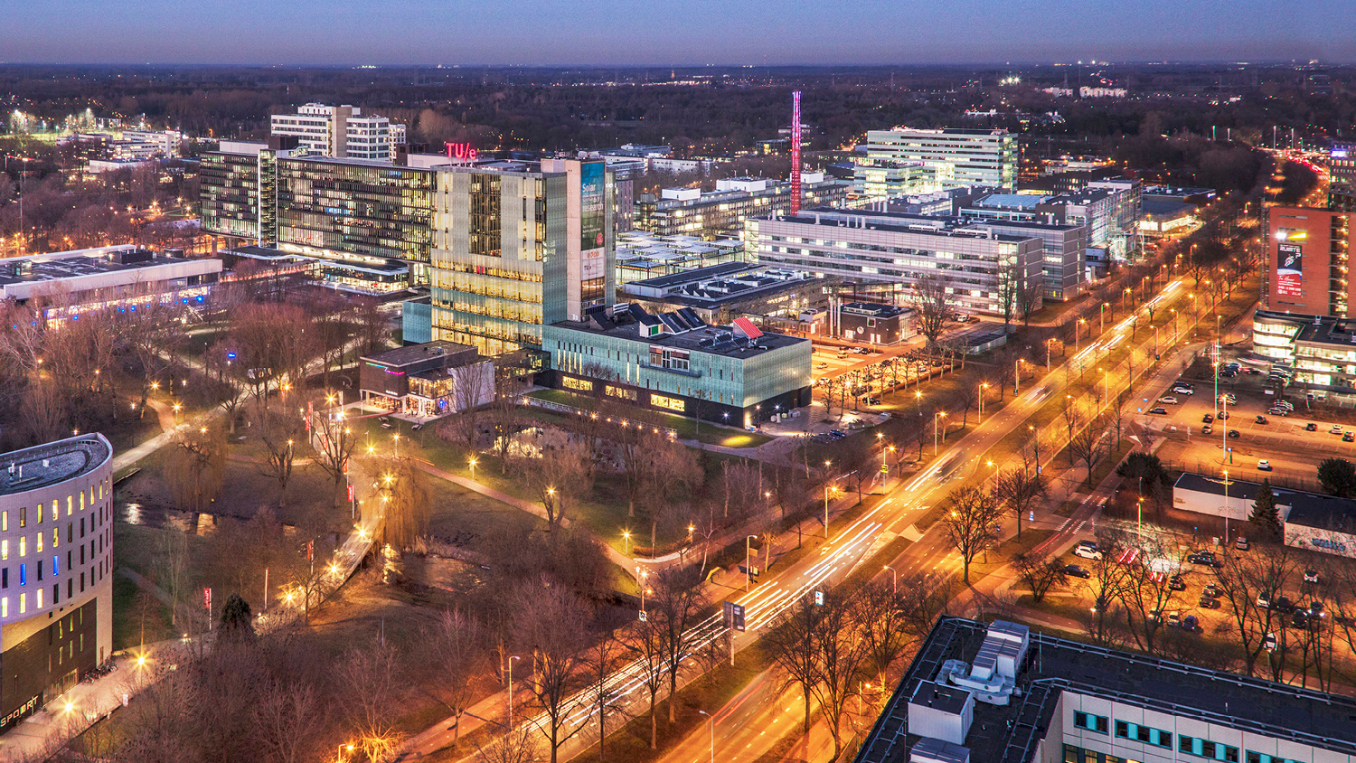
Structure Learning in High-Dimensional Time Series Data
Final project Presentation, 14-07-2022
Martin de Quincey
Mathematics and Computer Science

Slide 2
Table of content
Introduction
Problem Setting
Methodologies
Results
Conclusion
Future Directions

Slide 3

Problem Setting
Based on time series data, learn the structure of a graphical model
Arc $(x, y)$ => $x$ “is useful” in predicting $y$
Inferred structure must be acyclic

Slide 4
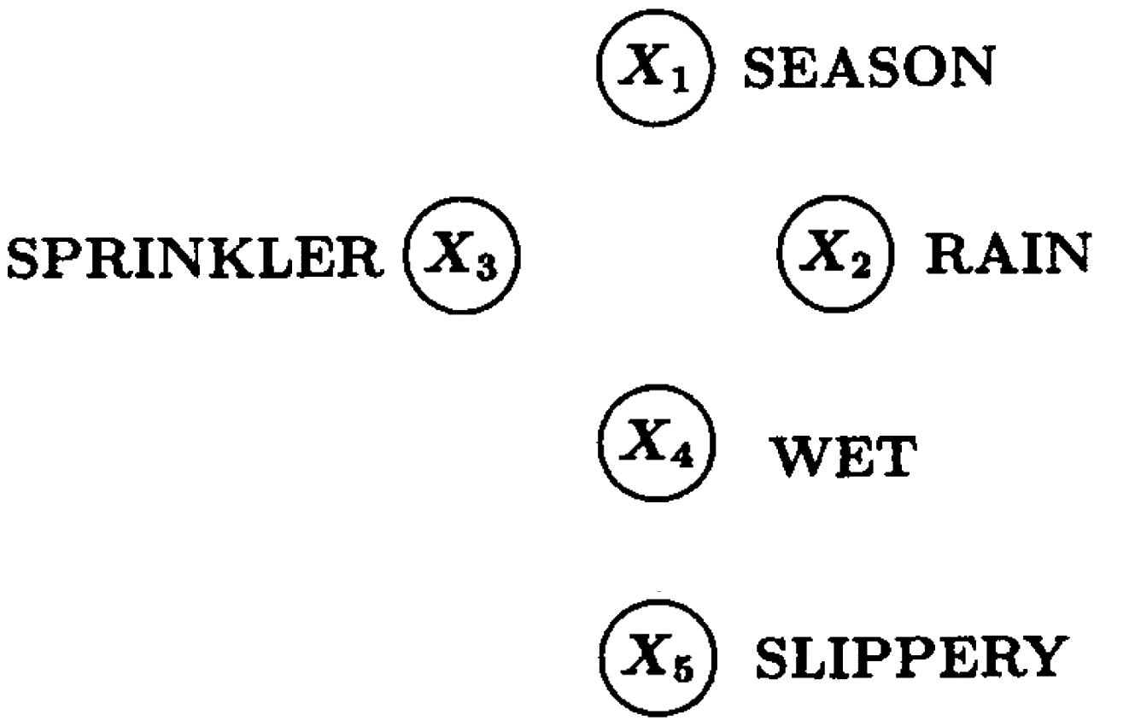
Problem Setting – Example [1]

Slide 5

Problem Setting – Example [1]

Slide 6

Problem Setting – Example [1]

Slide 7

Problem Setting – Example [1]

Slide 8
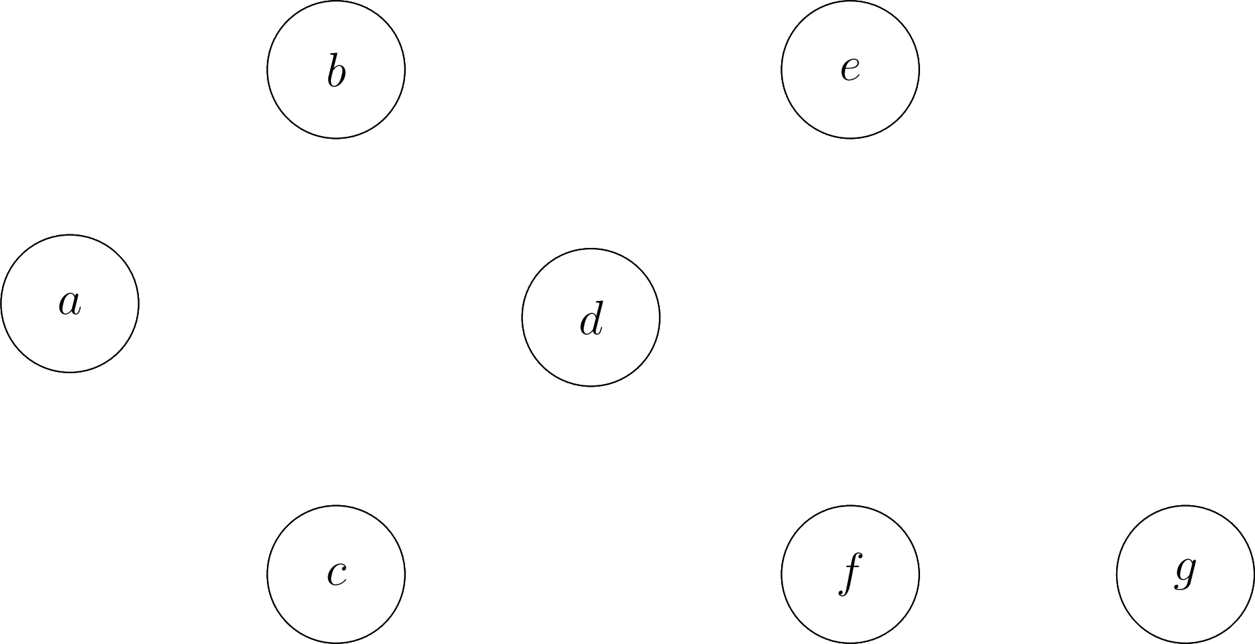
Motivation – Root Cause Analysis in Complex Systems

Slide 9
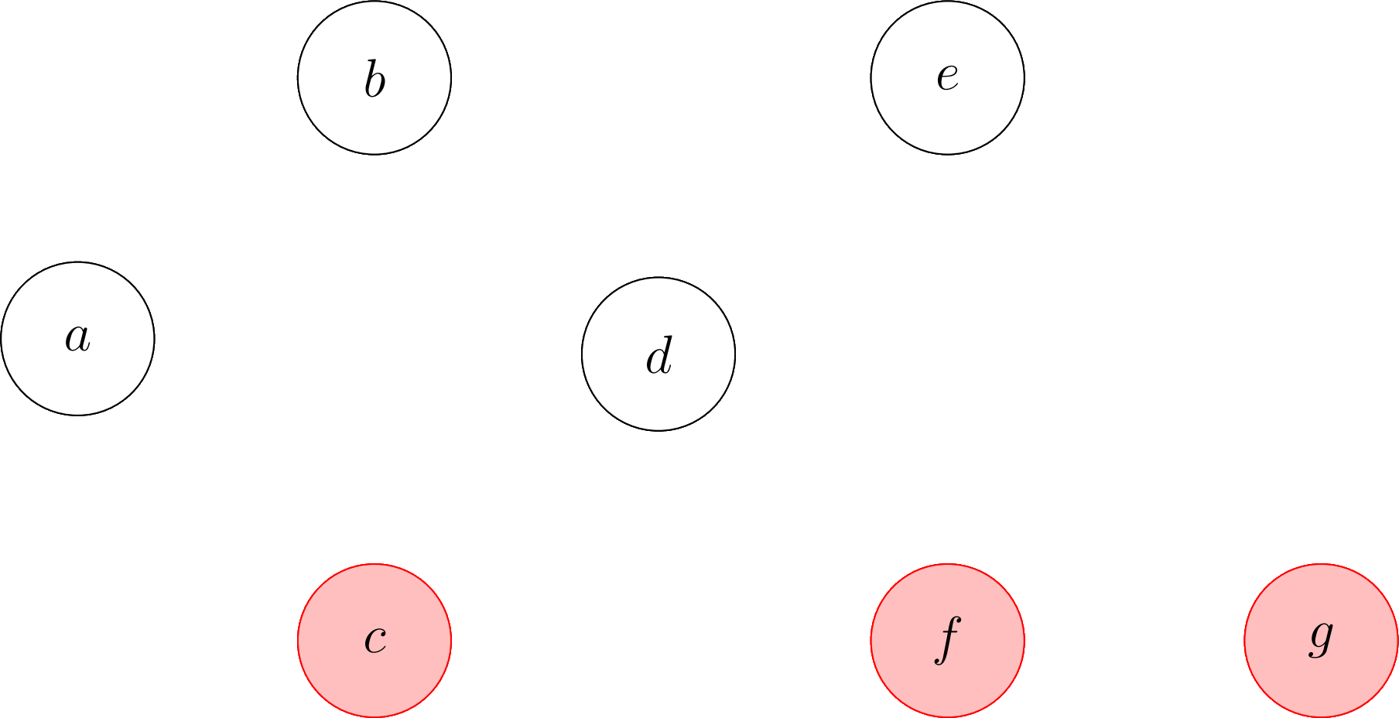
Motivation – Root Cause Analysis in Complex Systems

Slide 10

Motivation – Root Cause Analysis in Complex Systems

Slide 11
Motivation – Root Cause Analysis in Complex Systems

Slide 12
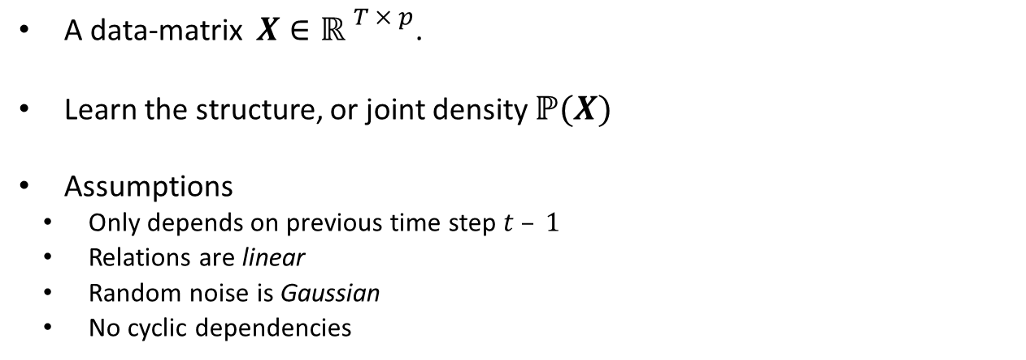
Formal Problem Setting
A data-matrix $X∈{ℝ }^{T × p}$.
Learn the structure, or joint density $ℙ(X)$
Assumptions
Only depends on previous time step $t – 1$
Relations are linear
Random noise is Gaussian
No cyclic dependencies

Slide 13
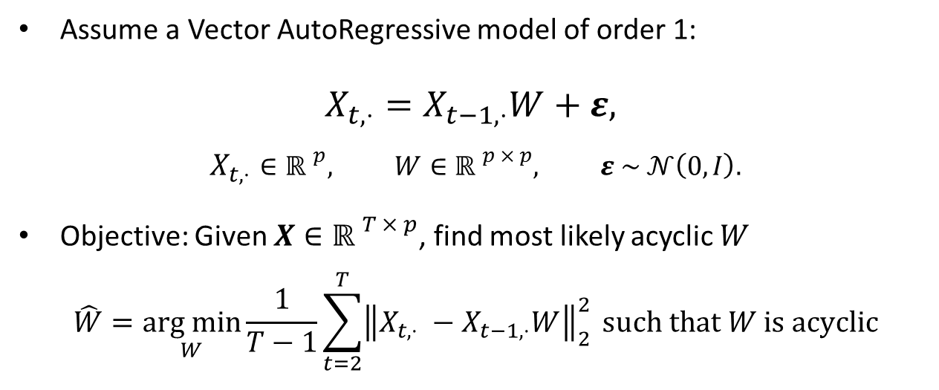
Model
Assume a Vector AutoRegressive model of order 1:
$$X_{t, ⋅}=X_{t−1, ⋅}W+ε,$$
$$X_{t, ⋅}∈{ℝ }^{p}, W∈{ℝ }^{p × p}, ε \sim 𝒩\left(0, I\right).$$
Objective: Given $X∈{ℝ }^{T × p}$, find most likely acyclic $W$
$$\hat{W}=\underset{W}{arg min}{\frac{1}{T−1}\sum_{t=2}^{T}{{\left\|X_{t,⋅} −X_{t−1,⋅}W\right\|}_{2}^{2}}}{ such that W is acyclic }$$

Slide 14
Methodologies
Permutation-Based
Greedy Random Walk
Iterative
Orthogonal Matching Pursuit
Continuous
NOTEARS

Slide 15
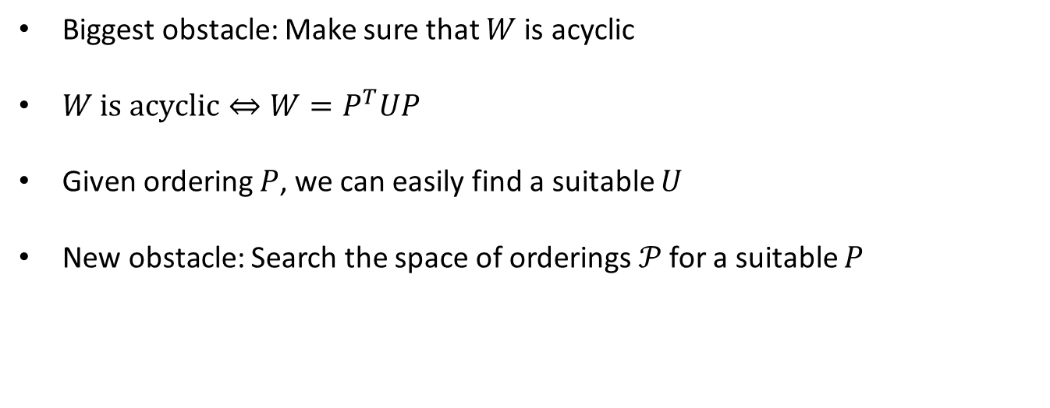
1) Orderings
Biggest obstacle: Make sure that $W$ is acyclic
$W \text{is} \text{a}cyclic⇔{W=P}^{T}UP$
Given ordering $P$, we can easily find a suitable $U$
New obstacle: Search the space of orderings$𝒫$ for a suitable $P$

Slide 16
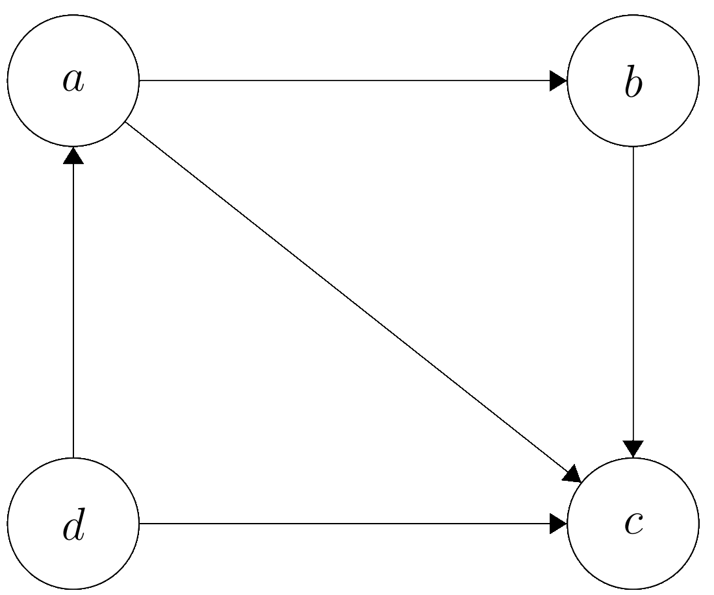
1) Orderings

Slide 17
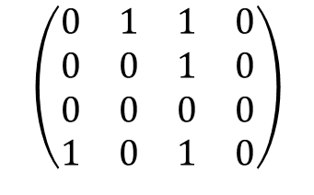


1) Orderings
$$a b c d$$
$$a$$
$$b$$
$$c$$
$$d$$
$$\left(\begin{matrix}0 & 1 & 1 & 0 \\ 0 & 0 & 1 & 0 \\ 0 & 0 & 0 & 0 \\ 1 & 0 & 1 & 0\end{matrix}\right)$$

Slide 18


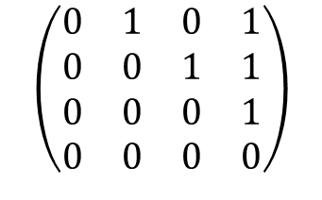
1) Orderings
$$a b c d$$
$$a$$
$$b$$
$$c$$
$$d$$
$$\left(\begin{matrix}0 & 1 & 1 & 0 \\ 0 & 0 & 1 & 0 \\ 0 & 0 & 0 & 0 \\ 1 & 0 & 1 & 0\end{matrix}\right)$$
$$d a b c$$
$$d$$
$$a$$
$$b$$
$$c$$
$$\left(\begin{matrix}0 & 1 & 0 & 1 \\ 0 & 0 & 1 & 1 \\ 0 & 0 & 0 & 1 \\ 0 & 0 & 0 & 0\end{matrix}\right)$$

Slide 19
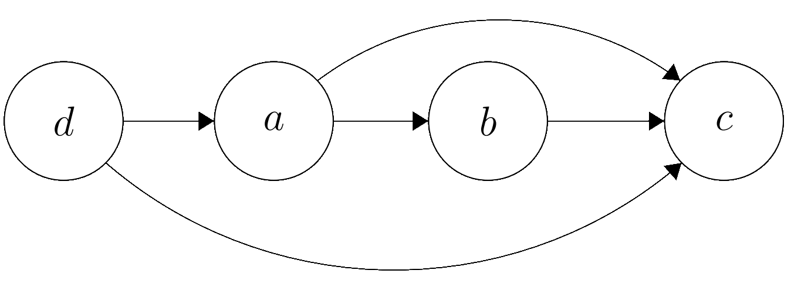
1) Orderings
$$a b c d$$
$$a$$
$$b$$
$$c$$
$$d$$
$$\left(\begin{matrix}0 & 1 & 1 & 0 \\ 0 & 0 & 1 & 0 \\ 0 & 0 & 0 & 0 \\ 1 & 0 & 1 & 0\end{matrix}\right)$$
$$d a b c$$
$$d$$
$$a$$
$$b$$
$$c$$
$$\left(\begin{matrix}0 & 1 & 0 & 1 \\ 0 & 0 & 1 & 1 \\ 0 & 0 & 0 & 1 \\ 0 & 0 & 0 & 0\end{matrix}\right)$$

Slide 20

1) Random Walk
Exhaustively trying all orderings is $𝒪(p!)$
Random walk on the set of orderings
Possible transitions: Swapping two variables in the ordering

Slide 21
1) Greedy Random Walk
Randomly swap the order of two variables
Transition to this new ordering if it achieves a better score
Iterate until time-out

Slide 22

1) Greedy Random Walk

Slide 23

1) Greedy Random Walk
Ordering $(1, 2, 3).$

Slide 24

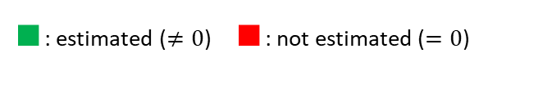
1) Greedy Random Walk
$∎$: estimated ($≠0$) $∎$: not estimated ($=0$)
Ordering $(1, 2, 3).$
$$\left(\begin{matrix}∎ & ∎ & ∎ \\ ∎ & ∎ & ∎ \\ ∎ & ∎ & ∎\end{matrix}\right)$$

Slide 25

1) Greedy Random Walk
$∎$: estimated ($≠0$) $∎$: not estimated ($=0$)
Ordering $(1, 2, 3).$
Try $(1, 3, 2)$
$$\left(\begin{matrix}∎ & ∎ & ∎ \\ ∎ & ∎ & ∎ \\ ∎ & ∎ & ∎\end{matrix}\right)$$

Slide 26

1) Greedy Random Walk
$∎$: estimated ($≠0$) $∎$: not estimated ($=0$)
Ordering $(1, 2, 3).$
Try $(1, 3, 2)$
$$\left(\begin{matrix}∎ & ∎ & ∎ \\ ∎ & ∎ & ∎ \\ ∎ & ∎ & ∎\end{matrix}\right)$$
$$\left(\begin{matrix}∎ & ∎ & ∎ \\ ∎ & ∎ & ∎ \\ ∎ & ∎ & ∎\end{matrix}\right)$$

Slide 27

1) Greedy Random Walk
$∎$: estimated ($≠0$) $∎$: not estimated ($=0$)
Ordering $(1, 2, 3).$
Try $(1, 3, 2)$
$$\left(\begin{matrix}∎ & ∎ & ∎ \\ ∎ & ∎ & ∎ \\ ∎ & ∎ & ∎\end{matrix}\right)$$
$⟹$no improvement.
$$\left(\begin{matrix}∎ & ∎ & ∎ \\ ∎ & ∎ & ∎ \\ ∎ & ∎ & ∎\end{matrix}\right)$$

Slide 28
1) Greedy Random Walk
$∎$: estimated ($≠0$) $∎$: not estimated ($=0$)
Ordering $(1, 2, 3).$
Try $(1, 3, 2)$
$$\left(\begin{matrix}∎ & ∎ & ∎ \\ ∎ & ∎ & ∎ \\ ∎ & ∎ & ∎\end{matrix}\right)$$
$⟹$no improvement.

Slide 29

1) Greedy Random Walk
$∎$: estimated ($≠0$) $∎$: not estimated ($=0$)
Ordering $(1, 2, 3).$
Try $(1, 3, 2)$
Try $(2, 1, 3)$
$$\left(\begin{matrix}∎ & ∎ & ∎ \\ ∎ & ∎ & ∎ \\ ∎ & ∎ & ∎\end{matrix}\right)$$
$⟹$no improvement.

Slide 30
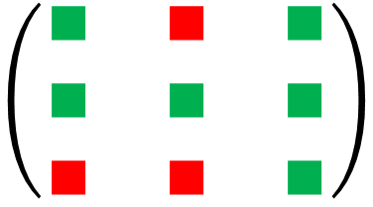
1) Greedy Random Walk
$∎$: estimated ($≠0$) $∎$: not estimated ($=0$)
Ordering $(1, 2, 3).$
Try $(1, 3, 2)$
Try $(2, 1, 3)$
$$\left(\begin{matrix}∎ & ∎ & ∎ \\ ∎ & ∎ & ∎ \\ ∎ & ∎ & ∎\end{matrix}\right)$$
$⟹$no improvement.
$$\left(\begin{matrix}∎ & ∎ & ∎ \\ ∎ & ∎ & ∎ \\ ∎ & ∎ & ∎\end{matrix}\right)$$

Slide 31

1) Greedy Random Walk
$∎$: estimated ($≠0$) $∎$: not estimated ($=0$)
Ordering $(1, 2, 3).$
Try $(1, 3, 2)$
Try $(2, 1, 3)$
$$\left(\begin{matrix}∎ & ∎ & ∎ \\ ∎ & ∎ & ∎ \\ ∎ & ∎ & ∎\end{matrix}\right)$$
$⟹$no improvement.
$⟹$ improvement.
$$\left(\begin{matrix}∎ & ∎ & ∎ \\ ∎ & ∎ & ∎ \\ ∎ & ∎ & ∎\end{matrix}\right)$$

Slide 32
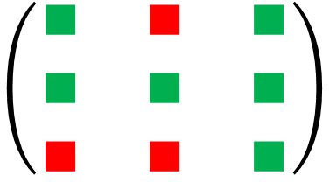
1) Greedy Random Walk
$∎$: estimated ($≠0$) $∎$: not estimated ($=0$)
Ordering $(1, 2, 3).$
Try $(1, 3, 2)$
Try $(2, 1, 3)$
$$\left(\begin{matrix}∎ & ∎ & ∎ \\ ∎ & ∎ & ∎ \\ ∎ & ∎ & ∎\end{matrix}\right)$$
$⟹$no improvement.
$⟹$ improvement.

Slide 33


1) Greedy Random Walk
$∎$: estimated ($≠0$) $∎$: not estimated ($=0$)
Ordering $(1, 2, 3).$
Try $(1, 3, 2)$
Try $(2, 1, 3)$
Try $(2, 3, 1)$
$$\left(\begin{matrix}∎ & ∎ & ∎ \\ ∎ & ∎ & ∎ \\ ∎ & ∎ & ∎\end{matrix}\right)$$
$⟹$no improvement.
$⟹$ improvement.

Slide 34
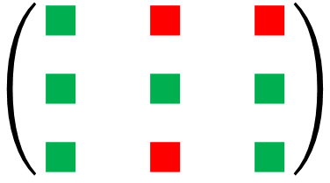
1) Greedy Random Walk
$∎$: estimated ($≠0$) $∎$: not estimated ($=0$)
Ordering $(1, 2, 3).$
Try $(1, 3, 2)$
Try $(2, 1, 3)$
Try $(2, 3, 1)$
$$\left(\begin{matrix}∎ & ∎ & ∎ \\ ∎ & ∎ & ∎ \\ ∎ & ∎ & ∎\end{matrix}\right)$$
$⟹$no improvement.
$⟹$ improvement.
$$\left(\begin{matrix}∎ & ∎ & ∎ \\ ∎ & ∎ & ∎ \\ ∎ & ∎ & ∎\end{matrix}\right)$$

Slide 35

1) Greedy Random Walk
$∎$: estimated ($≠0$) $∎$: not estimated ($=0$)
Ordering $(1, 2, 3).$
Try $(1, 3, 2)$
Try $(2, 1, 3)$
Try $(2, 3, 1)$
$$\left(\begin{matrix}∎ & ∎ & ∎ \\ ∎ & ∎ & ∎ \\ ∎ & ∎ & ∎\end{matrix}\right)$$
$⟹$no improvement.
$⟹$ improvement.
$⟹$ no improvement.
$$\left(\begin{matrix}∎ & ∎ & ∎ \\ ∎ & ∎ & ∎ \\ ∎ & ∎ & ∎\end{matrix}\right)$$

Slide 36
1) Greedy Random Walk
$∎$: estimated ($≠0$) $∎$: not estimated ($=0$)
Ordering $(1, 2, 3).$
Try $(1, 3, 2)$
Try $(2, 1, 3)$
Try $(2, 3, 1)$
$$\left(\begin{matrix}∎ & ∎ & ∎ \\ ∎ & ∎ & ∎ \\ ∎ & ∎ & ∎\end{matrix}\right)$$
$⟹$no improvement.
$⟹$ improvement.
$⟹$ no improvement.

Slide 37

1) Greedy Random Walk
$∎$: estimated ($≠0$) $∎$: not estimated ($=0$)
Ordering $(1, 2, 3).$
Try $(1, 3, 2)$
Try $(2, 1, 3)$
Try $\left(2, 3, 1\right)$
Try $\left(3, 2, 1\right)$
$$\left(\begin{matrix}∎ & ∎ & ∎ \\ ∎ & ∎ & ∎ \\ ∎ & ∎ & ∎\end{matrix}\right)$$
$⟹$no improvement.
$⟹$ improvement.
$⟹$ no improvement.

Slide 38
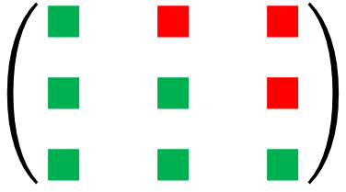
1) Greedy Random Walk
$∎$: estimated ($≠0$) $∎$: not estimated ($=0$)
Ordering $(1, 2, 3).$
Try $(1, 3, 2)$
Try $(2, 1, 3)$
Try $\left(2, 3, 1\right)$
Try $\left(3, 2, 1\right)$
$$\left(\begin{matrix}∎ & ∎ & ∎ \\ ∎ & ∎ & ∎ \\ ∎ & ∎ & ∎\end{matrix}\right)$$
$⟹$no improvement.
$⟹$ improvement.
$⟹$ no improvement.
$$\left(\begin{matrix}∎ & ∎ & ∎ \\ ∎ & ∎ & ∎ \\ ∎ & ∎ & ∎\end{matrix}\right)$$

Slide 39

1) Greedy Random Walk
$∎$: estimated ($≠0$) $∎$: not estimated ($=0$)
Ordering $(1, 2, 3).$
Try $(1, 3, 2)$
Try $(2, 1, 3)$
Try $\left(2, 3, 1\right)$
Try $\left(3, 2, 1\right)$
$$\left(\begin{matrix}∎ & ∎ & ∎ \\ ∎ & ∎ & ∎ \\ ∎ & ∎ & ∎\end{matrix}\right)$$
$⟹$no improvement.
$⟹$ improvement.
$⟹$ no improvement.
$⟹$ improvement.
$$\left(\begin{matrix}∎ & ∎ & ∎ \\ ∎ & ∎ & ∎ \\ ∎ & ∎ & ∎\end{matrix}\right)$$

Slide 40
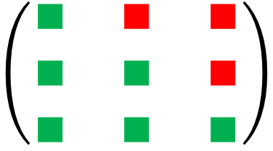
1) Greedy Random Walk
$∎$: estimated ($≠0$) $∎$: not estimated ($=0$)
Ordering $(1, 2, 3).$
Try $(1, 3, 2)$
Try $(2, 1, 3)$
Try $\left(2, 3, 1\right)$
Try $\left(3, 2, 1\right)$
$$\left(\begin{matrix}∎ & ∎ & ∎ \\ ∎ & ∎ & ∎ \\ ∎ & ∎ & ∎\end{matrix}\right)$$
$⟹$no improvement.
$⟹$ improvement.
$⟹$ no improvement.
$⟹$ improvement.

Slide 41

1) Greedy Random Walk
$∎$: estimated ($≠0$) $∎$: not estimated ($=0$)
Ordering $(1, 2, 3).$
Try $(1, 3, 2)$
Try $(2, 1, 3)$
Try $\left(2, 3, 1\right)$
Try $\left(3, 2, 1\right)$
No improvements found.
$$\left(\begin{matrix}∎ & ∎ & ∎ \\ ∎ & ∎ & ∎ \\ ∎ & ∎ & ∎\end{matrix}\right)$$
$⟹$no improvement.
$⟹$ improvement.
$⟹$ no improvement.
$⟹$ improvement.

Slide 42


1) Greedy Random Walk
$∎$: estimated ($≠0$) $∎$: not estimated ($=0$)
Ordering $(1, 2, 3).$
Try $(1, 3, 2)$
Try $(2, 1, 3)$
Try $(2, 3, 1)$
Try $(3, 2, 1)$
No improvements found.
$$\left(\begin{matrix}∎ & ∎ & ∎ \\ ∎ & ∎ & ∎ \\ ∎ & ∎ & ∎\end{matrix}\right)$$
$⟹$no improvement.
$⟹$ improvement.
$⟹$ no improvement.
$⟹$ improvement.
$$\left(\begin{matrix}∎ & ∎ & ∎ \\ ∎ & ∎ & ∎ \\ ∎ & ∎ & ∎\end{matrix}\right)$$
$$\left(\begin{matrix}∎ & ∎ & ∎ \\ ∎ & ∎ & ∎ \\ ∎ & ∎ & ∎\end{matrix}\right)$$
$$\left(\begin{matrix}∎ & ∎ & ∎ \\ ∎ & ∎ & ∎ \\ ∎ & ∎ & ∎\end{matrix}\right)$$
$$\left(\begin{matrix}∎ & ∎ & ∎ \\ ∎ & ∎ & ∎ \\ ∎ & ∎ & ∎\end{matrix}\right)$$

Slide 43
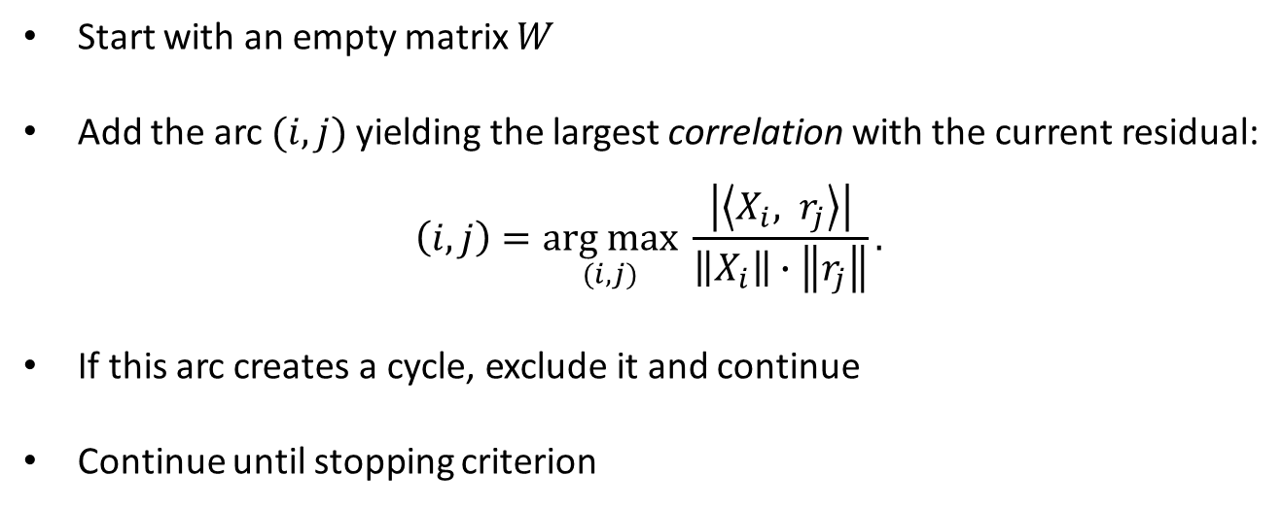
2) Orthogonal Matching Pursuit
Start with an empty matrix $W$
Add the arc $(i, j)$yielding the largest correlation with the current residual:
$$\left(i, j\right)=\underset{(i, j)}{arg max}{\frac{\left|\left\langle X_{i}, r_{j}\right\rangle \right|}{\left\|X_{i}\right\|∙\left\|r_{j}\right\|}}.$$
If this arc creates a cycle, exclude it and continue
Continue until stopping criterion

Slide 44
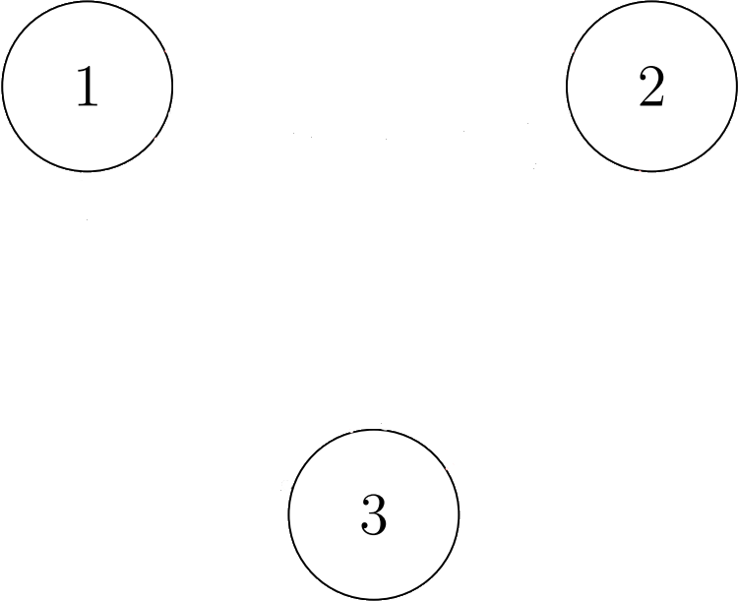
2) Orthogonal Matching Pursuit

Slide 45
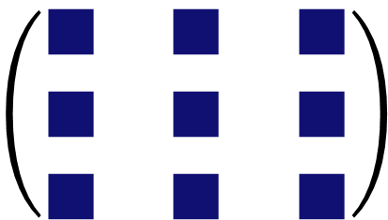

2) Orthogonal Matching Pursuit
$$\left(\begin{matrix}∎ & ∎ & ∎ \\ ∎ & ∎ & ∎ \\ ∎ & ∎ & ∎\end{matrix}\right)$$
$∎$: not decided yet
$∎$: estimated ($≠0$)
$∎$: not estimated ($=0$)

Slide 46
2) Orthogonal Matching Pursuit
1 4 9
5 2 6
7 8 3
$$\left(\begin{matrix}∎ & ∎ & ∎ \\ ∎ & ∎ & ∎ \\ ∎ & ∎ & ∎\end{matrix}\right)$$
$∎$: not decided yet
$∎$: estimated ($≠0$)
$∎$: not estimated ($=0$)

Slide 47
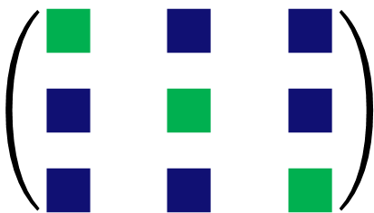
2) Orthogonal Matching Pursuit
1 4 9
5 2 6
7 8 3
$$\left(\begin{matrix}∎ & ∎ & ∎ \\ ∎ & ∎ & ∎ \\ ∎ & ∎ & ∎\end{matrix}\right)$$
$$\left(\begin{matrix}∎ & ∎ & ∎ \\ ∎ & ∎ & ∎ \\ ∎ & ∎ & ∎\end{matrix}\right)$$
$∎$: not decided yet
$∎$: estimated ($≠0$)
$∎$: not estimated ($=0$)

Slide 48
2) Orthogonal Matching Pursuit
1 4 9
5 2 6
7 8 3
$$\left(\begin{matrix}∎ & ∎ & ∎ \\ ∎ & ∎ & ∎ \\ ∎ & ∎ & ∎\end{matrix}\right)$$
$$\left(\begin{matrix}∎ & ∎ & ∎ \\ ∎ & ∎ & ∎ \\ ∎ & ∎ & ∎\end{matrix}\right)$$
$∎$: not decided yet
$∎$: estimated ($≠0$)
$∎$: not estimated ($=0$)

Slide 49
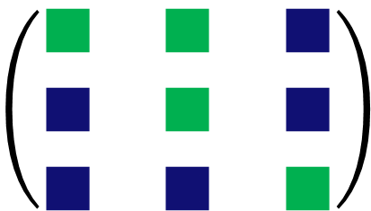
2) Orthogonal Matching Pursuit
1 4 9
5 2 6
7 8 3
$$\left(\begin{matrix}∎ & ∎ & ∎ \\ ∎ & ∎ & ∎ \\ ∎ & ∎ & ∎\end{matrix}\right)$$
$$\left(\begin{matrix}∎ & ∎ & ∎ \\ ∎ & ∎ & ∎ \\ ∎ & ∎ & ∎\end{matrix}\right)$$
$$\left(\begin{matrix}∎ & ∎ & ∎ \\ ∎ & ∎ & ∎ \\ ∎ & ∎ & ∎\end{matrix}\right)$$
$∎$: not decided yet
$∎$: estimated ($≠0$)
$∎$: not estimated ($=0$)

Slide 50

2) Orthogonal Matching Pursuit
1 4 9
5 2 6
7 8 3
$$\left(\begin{matrix}∎ & ∎ & ∎ \\ ∎ & ∎ & ∎ \\ ∎ & ∎ & ∎\end{matrix}\right)$$
$$\left(\begin{matrix}∎ & ∎ & ∎ \\ ∎ & ∎ & ∎ \\ ∎ & ∎ & ∎\end{matrix}\right)$$
$$\left(\begin{matrix}∎ & ∎ & ∎ \\ ∎ & ∎ & ∎ \\ ∎ & ∎ & ∎\end{matrix}\right)$$
$∎$: not decided yet
$∎$: estimated ($≠0$)
$∎$: not estimated ($=0$)

Slide 51
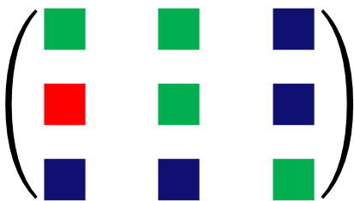
2) Orthogonal Matching Pursuit
1 4 9
5 2 6
7 8 3
$$\left(\begin{matrix}∎ & ∎ & ∎ \\ ∎ & ∎ & ∎ \\ ∎ & ∎ & ∎\end{matrix}\right)$$
$$\left(\begin{matrix}∎ & ∎ & ∎ \\ ∎ & ∎ & ∎ \\ ∎ & ∎ & ∎\end{matrix}\right)$$
$$\left(\begin{matrix}∎ & ∎ & ∎ \\ ∎ & ∎ & ∎ \\ ∎ & ∎ & ∎\end{matrix}\right)$$
$$\left(\begin{matrix}∎ & ∎ & ∎ \\ ∎ & ∎ & ∎ \\ ∎ & ∎ & ∎\end{matrix}\right)$$
$∎$: not decided yet
$∎$: estimated ($≠0$)
$∎$: not estimated ($=0$)

Slide 52
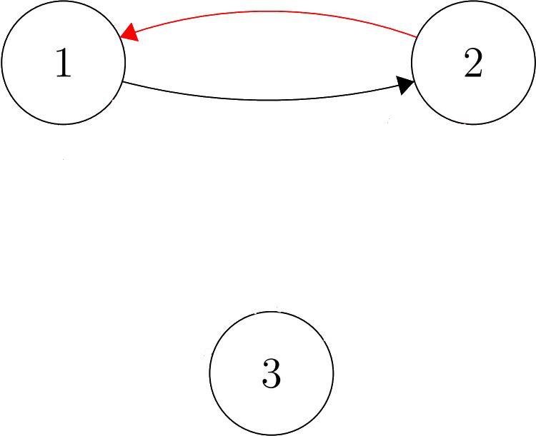
2) Orthogonal Matching Pursuit
1 4 9
5 2 6
7 8 3
$$\left(\begin{matrix}∎ & ∎ & ∎ \\ ∎ & ∎ & ∎ \\ ∎ & ∎ & ∎\end{matrix}\right)$$
$$\left(\begin{matrix}∎ & ∎ & ∎ \\ ∎ & ∎ & ∎ \\ ∎ & ∎ & ∎\end{matrix}\right)$$
$$\left(\begin{matrix}∎ & ∎ & ∎ \\ ∎ & ∎ & ∎ \\ ∎ & ∎ & ∎\end{matrix}\right)$$
$$\left(\begin{matrix}∎ & ∎ & ∎ \\ ∎ & ∎ & ∎ \\ ∎ & ∎ & ∎\end{matrix}\right)$$
$∎$: not decided yet
$∎$: estimated ($≠0$)
$∎$: not estimated ($=0$)

Slide 53
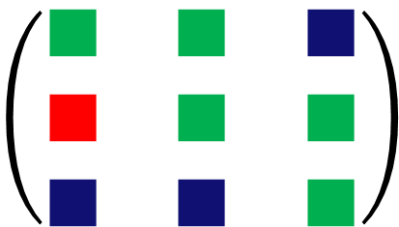
2) Orthogonal Matching Pursuit
1 4 9
5 2 6
7 8 3
$$\left(\begin{matrix}∎ & ∎ & ∎ \\ ∎ & ∎ & ∎ \\ ∎ & ∎ & ∎\end{matrix}\right)$$
$$\left(\begin{matrix}∎ & ∎ & ∎ \\ ∎ & ∎ & ∎ \\ ∎ & ∎ & ∎\end{matrix}\right)$$
$$\left(\begin{matrix}∎ & ∎ & ∎ \\ ∎ & ∎ & ∎ \\ ∎ & ∎ & ∎\end{matrix}\right)$$
$$\left(\begin{matrix}∎ & ∎ & ∎ \\ ∎ & ∎ & ∎ \\ ∎ & ∎ & ∎\end{matrix}\right)$$
$$\left(\begin{matrix}∎ & ∎ & ∎ \\ ∎ & ∎ & ∎ \\ ∎ & ∎ & ∎\end{matrix}\right)$$
$∎$: not decided yet
$∎$: estimated ($≠0$)
$∎$: not estimated ($=0$)

Slide 54
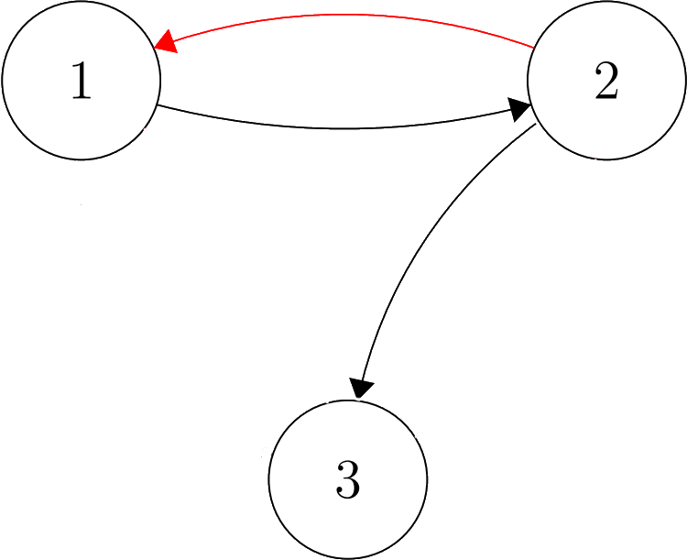
2) Orthogonal Matching Pursuit
1 4 9
5 2 6
7 8 3
$$\left(\begin{matrix}∎ & ∎ & ∎ \\ ∎ & ∎ & ∎ \\ ∎ & ∎ & ∎\end{matrix}\right)$$
$$\left(\begin{matrix}∎ & ∎ & ∎ \\ ∎ & ∎ & ∎ \\ ∎ & ∎ & ∎\end{matrix}\right)$$
$$\left(\begin{matrix}∎ & ∎ & ∎ \\ ∎ & ∎ & ∎ \\ ∎ & ∎ & ∎\end{matrix}\right)$$
$$\left(\begin{matrix}∎ & ∎ & ∎ \\ ∎ & ∎ & ∎ \\ ∎ & ∎ & ∎\end{matrix}\right)$$
$$\left(\begin{matrix}∎ & ∎ & ∎ \\ ∎ & ∎ & ∎ \\ ∎ & ∎ & ∎\end{matrix}\right)$$
$∎$: not decided yet
$∎$: estimated ($≠0$)
$∎$: not estimated ($=0$)

Slide 55
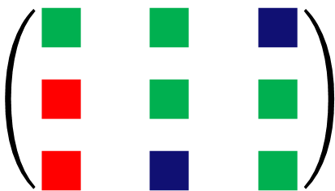
2) Orthogonal Matching Pursuit
1 4 9
5 2 6
7 8 3
$$\left(\begin{matrix}∎ & ∎ & ∎ \\ ∎ & ∎ & ∎ \\ ∎ & ∎ & ∎\end{matrix}\right)$$
$$\left(\begin{matrix}∎ & ∎ & ∎ \\ ∎ & ∎ & ∎ \\ ∎ & ∎ & ∎\end{matrix}\right)$$
$$\left(\begin{matrix}∎ & ∎ & ∎ \\ ∎ & ∎ & ∎ \\ ∎ & ∎ & ∎\end{matrix}\right)$$
$$\left(\begin{matrix}∎ & ∎ & ∎ \\ ∎ & ∎ & ∎ \\ ∎ & ∎ & ∎\end{matrix}\right)$$
$$\left(\begin{matrix}∎ & ∎ & ∎ \\ ∎ & ∎ & ∎ \\ ∎ & ∎ & ∎\end{matrix}\right)$$
$$\left(\begin{matrix}∎ & ∎ & ∎ \\ ∎ & ∎ & ∎ \\ ∎ & ∎ & ∎\end{matrix}\right)$$
$∎$: not decided yet
$∎$: estimated ($≠0$)
$∎$: not estimated ($=0$)

Slide 56
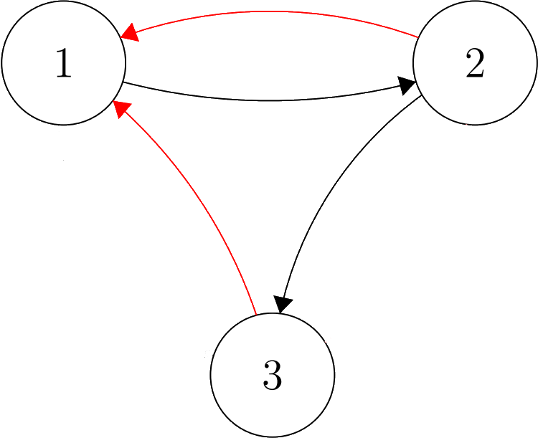
2) Orthogonal Matching Pursuit
1 4 9
5 2 6
7 8 3
$$\left(\begin{matrix}∎ & ∎ & ∎ \\ ∎ & ∎ & ∎ \\ ∎ & ∎ & ∎\end{matrix}\right)$$
$$\left(\begin{matrix}∎ & ∎ & ∎ \\ ∎ & ∎ & ∎ \\ ∎ & ∎ & ∎\end{matrix}\right)$$
$$\left(\begin{matrix}∎ & ∎ & ∎ \\ ∎ & ∎ & ∎ \\ ∎ & ∎ & ∎\end{matrix}\right)$$
$$\left(\begin{matrix}∎ & ∎ & ∎ \\ ∎ & ∎ & ∎ \\ ∎ & ∎ & ∎\end{matrix}\right)$$
$$\left(\begin{matrix}∎ & ∎ & ∎ \\ ∎ & ∎ & ∎ \\ ∎ & ∎ & ∎\end{matrix}\right)$$
$$\left(\begin{matrix}∎ & ∎ & ∎ \\ ∎ & ∎ & ∎ \\ ∎ & ∎ & ∎\end{matrix}\right)$$
$∎$: not decided yet
$∎$: estimated ($≠0$)
$∎$: not estimated ($=0$)

Slide 57
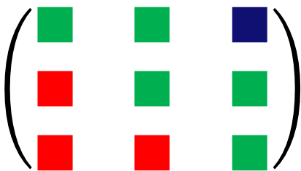
2) Orthogonal Matching Pursuit
1 4 9
5 2 6
7 8 3
$$\left(\begin{matrix}∎ & ∎ & ∎ \\ ∎ & ∎ & ∎ \\ ∎ & ∎ & ∎\end{matrix}\right)$$
$$\left(\begin{matrix}∎ & ∎ & ∎ \\ ∎ & ∎ & ∎ \\ ∎ & ∎ & ∎\end{matrix}\right)$$
$$\left(\begin{matrix}∎ & ∎ & ∎ \\ ∎ & ∎ & ∎ \\ ∎ & ∎ & ∎\end{matrix}\right)$$
$$\left(\begin{matrix}∎ & ∎ & ∎ \\ ∎ & ∎ & ∎ \\ ∎ & ∎ & ∎\end{matrix}\right)$$
$$\left(\begin{matrix}∎ & ∎ & ∎ \\ ∎ & ∎ & ∎ \\ ∎ & ∎ & ∎\end{matrix}\right)$$
$$\left(\begin{matrix}∎ & ∎ & ∎ \\ ∎ & ∎ & ∎ \\ ∎ & ∎ & ∎\end{matrix}\right)$$
$$\left(\begin{matrix}∎ & ∎ & ∎ \\ ∎ & ∎ & ∎ \\ ∎ & ∎ & ∎\end{matrix}\right)$$
$∎$: not decided yet
$∎$: estimated ($≠0$)
$∎$: not estimated ($=0$)

Slide 58
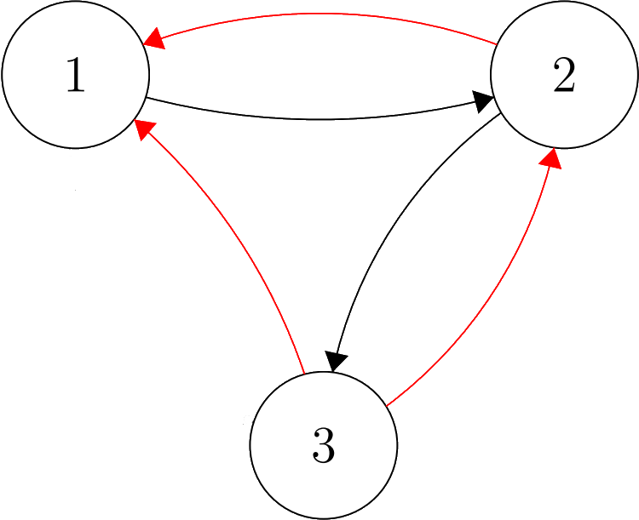
2) Orthogonal Matching Pursuit
1 4 9
5 2 6
7 8 3
$$\left(\begin{matrix}∎ & ∎ & ∎ \\ ∎ & ∎ & ∎ \\ ∎ & ∎ & ∎\end{matrix}\right)$$
$$\left(\begin{matrix}∎ & ∎ & ∎ \\ ∎ & ∎ & ∎ \\ ∎ & ∎ & ∎\end{matrix}\right)$$
$$\left(\begin{matrix}∎ & ∎ & ∎ \\ ∎ & ∎ & ∎ \\ ∎ & ∎ & ∎\end{matrix}\right)$$
$$\left(\begin{matrix}∎ & ∎ & ∎ \\ ∎ & ∎ & ∎ \\ ∎ & ∎ & ∎\end{matrix}\right)$$
$$\left(\begin{matrix}∎ & ∎ & ∎ \\ ∎ & ∎ & ∎ \\ ∎ & ∎ & ∎\end{matrix}\right)$$
$$\left(\begin{matrix}∎ & ∎ & ∎ \\ ∎ & ∎ & ∎ \\ ∎ & ∎ & ∎\end{matrix}\right)$$
$$\left(\begin{matrix}∎ & ∎ & ∎ \\ ∎ & ∎ & ∎ \\ ∎ & ∎ & ∎\end{matrix}\right)$$
$∎$: not decided yet
$∎$: estimated ($≠0$)
$∎$: not estimated ($=0$)

Slide 59
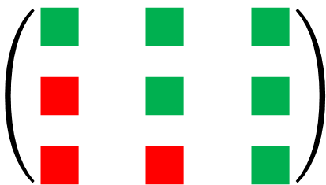
2) Orthogonal Matching Pursuit
1 4 9
5 2 6
7 8 3
$$\left(\begin{matrix}∎ & ∎ & ∎ \\ ∎ & ∎ & ∎ \\ ∎ & ∎ & ∎\end{matrix}\right)$$
$$\left(\begin{matrix}∎ & ∎ & ∎ \\ ∎ & ∎ & ∎ \\ ∎ & ∎ & ∎\end{matrix}\right)$$
$$\left(\begin{matrix}∎ & ∎ & ∎ \\ ∎ & ∎ & ∎ \\ ∎ & ∎ & ∎\end{matrix}\right)$$
$$\left(\begin{matrix}∎ & ∎ & ∎ \\ ∎ & ∎ & ∎ \\ ∎ & ∎ & ∎\end{matrix}\right)$$
$$\left(\begin{matrix}∎ & ∎ & ∎ \\ ∎ & ∎ & ∎ \\ ∎ & ∎ & ∎\end{matrix}\right)$$
$$\left(\begin{matrix}∎ & ∎ & ∎ \\ ∎ & ∎ & ∎ \\ ∎ & ∎ & ∎\end{matrix}\right)$$
$$\left(\begin{matrix}∎ & ∎ & ∎ \\ ∎ & ∎ & ∎ \\ ∎ & ∎ & ∎\end{matrix}\right)$$
$$\left(\begin{matrix}∎ & ∎ & ∎ \\ ∎ & ∎ & ∎ \\ ∎ & ∎ & ∎\end{matrix}\right)$$
$∎$: not decided yet
$∎$: estimated ($≠0$)
$∎$: not estimated ($=0$)

Slide 60
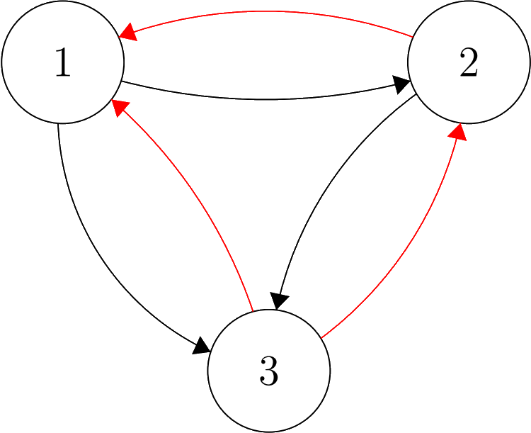
2) Orthogonal Matching Pursuit
1 4 9
5 2 6
7 8 3
$$\left(\begin{matrix}∎ & ∎ & ∎ \\ ∎ & ∎ & ∎ \\ ∎ & ∎ & ∎\end{matrix}\right)$$
$$\left(\begin{matrix}∎ & ∎ & ∎ \\ ∎ & ∎ & ∎ \\ ∎ & ∎ & ∎\end{matrix}\right)$$
$$\left(\begin{matrix}∎ & ∎ & ∎ \\ ∎ & ∎ & ∎ \\ ∎ & ∎ & ∎\end{matrix}\right)$$
$$\left(\begin{matrix}∎ & ∎ & ∎ \\ ∎ & ∎ & ∎ \\ ∎ & ∎ & ∎\end{matrix}\right)$$
$$\left(\begin{matrix}∎ & ∎ & ∎ \\ ∎ & ∎ & ∎ \\ ∎ & ∎ & ∎\end{matrix}\right)$$
$$\left(\begin{matrix}∎ & ∎ & ∎ \\ ∎ & ∎ & ∎ \\ ∎ & ∎ & ∎\end{matrix}\right)$$
$$\left(\begin{matrix}∎ & ∎ & ∎ \\ ∎ & ∎ & ∎ \\ ∎ & ∎ & ∎\end{matrix}\right)$$
$$\left(\begin{matrix}∎ & ∎ & ∎ \\ ∎ & ∎ & ∎ \\ ∎ & ∎ & ∎\end{matrix}\right)$$
$∎$: not decided yet
$∎$: estimated ($≠0$)
$∎$: not estimated ($=0$)

Slide 61
2) Orthogonal Matching Pursuit
1 4 6
5 2 5
7 8 3
$$\left(\begin{matrix}∎ & ∎ & ∎ \\ ∎ & ∎ & ∎ \\ ∎ & ∎ & ∎\end{matrix}\right)$$
$$\left(\begin{matrix}∎ & ∎ & ∎ \\ ∎ & ∎ & ∎ \\ ∎ & ∎ & ∎\end{matrix}\right)$$
$$\left(\begin{matrix}∎ & ∎ & ∎ \\ ∎ & ∎ & ∎ \\ ∎ & ∎ & ∎\end{matrix}\right)$$
$$\left(\begin{matrix}∎ & ∎ & ∎ \\ ∎ & ∎ & ∎ \\ ∎ & ∎ & ∎\end{matrix}\right)$$
$$\left(\begin{matrix}∎ & ∎ & ∎ \\ ∎ & ∎ & ∎ \\ ∎ & ∎ & ∎\end{matrix}\right)$$
$$\left(\begin{matrix}∎ & ∎ & ∎ \\ ∎ & ∎ & ∎ \\ ∎ & ∎ & ∎\end{matrix}\right)$$
$$\left(\begin{matrix}∎ & ∎ & ∎ \\ ∎ & ∎ & ∎ \\ ∎ & ∎ & ∎\end{matrix}\right)$$
$$\left(\begin{matrix}∎ & ∎ & ∎ \\ ∎ & ∎ & ∎ \\ ∎ & ∎ & ∎\end{matrix}\right)$$
$∎$: not decided yet
$∎$: estimated ($≠0$)
$∎$: not estimated ($=0$)

Slide 62

2) Selecting a suitable number of arcs
Iterative approaches constructs $W$ one arc per iteration
The gain in predictive performance decreases as we add more arcs
When does adding an arc not yield sufficient gain anymore?

Slide 63

2) Selecting a suitable number of arcs

Slide 64

2) Selecting a suitable number of arcs
Leave-one-out cross-validation
$$LOOCV_{t}\left(W_{k}\right)= {\left\|X_{t,⋅} −X_{t−1,⋅}W_{k}^{(−t)}\right\|}_{2}^{2}$$
$$LOOCV\left(W_{k}\right) = \frac{1}{T−1}\sum_{t=2}^{T}{LOOCV_{t}\left(W_{k}\right)}$$
How to choose a suitable number of arcs?
$$k^{∗}=\underset{k}{arg min}LOOCV\left(W_{k}\right)$$

Slide 65

2) Selecting a suitable number of arcs

Slide 66



3) NOTEARS
Paper from 2015 by Xun Zheng et al. [2]
Translated the problem from
$h(W) = 0 ⟺ W$ is acyclic.
$$\min_{W} \frac{1}{T−1}\sum_{t=2}^{T}{{\left\|X_{t,⋅} −X_{t−1,⋅}W\right\|}_{2}^{2}}$$
$$such that W is acyclic,$$
$$\min_{W} \frac{1}{T−1}\sum_{t=2}^{T}{{\left\|X_{t,⋅} −X_{t−1,⋅}W\right\|}_{2}^{2}}$$
$$such that h\left(W\right)=0.$$
to

Slide 67

Experimental Results
Vary number of variables $p ∈ \{5, 10, 15, 25, 50\}$.
Generate ten acyclic $W$ with a total of $s = 3p$arcs per value of $p$
Generate ten data matrices $X$ of 1000 time steps
Estimate $\hat{W}$ using all three methods
Compare Structural Hamming Distance and Excess Expected Loss

Slide 68

Structural Hamming Distance

Slide 69

Expected Excess Risk

Slide 70

Recovering causal pathways using structure learning

Slide 71
Recovering causal pathways using structure learning
Method | Predicted arcs | TP (out of 20) | SHD | Empirical Risk
Random Walk | 13 | 6 | 21 | 5.037
Regular MH | 15 | 7 | 21 | 5.051
Greedy MH | 17 | 8 | 21 | 4.998
NOTEARS | 16 | 8 | 22 | 5.032
DAG-OMP | 17 | 8 | 21 | 5.000
DAG-OLS-V | 14 | 7 | 20 | 5.156

Slide 72

Conclusions
Structure learning for high-dimensional data
Two methods competitive with state of the art
Greedy Random Walk
Performs well on sparse graphs
Competitive in low-dimensional settings
Orthogonal Matching Pursuit
Method is very fast ($≈1,000$ times faster than NOTEARS)
Competitive in high-dimensional settings

Slide 73
Future Directions
Extending the model
Investigate regularization
Statistical guarantees

Slide 74
References
wwwwwwwwwwww
[1] Pearl, J. (1997). Causality: Models, Reasoning, and Inference, Second Edition, p.15 .
[2] Zheng, X., Aragam, B., Ravikumar, P., Xing, E. (2018) DAGs with NO TEARS: Continuous Optimization for Structure Learning. Proceedings of the 32nd International Conference on Neural Information Processing Systems. p.9492-9503.

Slide 75

2) Selecting a suitable number of arcs

